Slide 1
OPTIMIZING SAFETY DRIVEN
NAVIGATION AID FOR VISUALLY IMPAIRED
Batch No: 03
Team Members:
Agalya K (211521205008)
Sai Sruthi AS (211521205014)
Anbarasi K (211521205015)
Guided By:
Dr.G.Dhanalakshmi, M.E.,Ph.D
Head Of The Department
Department of Information Technology
Panimalar Institute Of Technology

Slide 2
Abstract
In recent times Urban navigation is challenging for visually impaired people due to lack of obstacle awareness.
We propose a smart system to improve mobility and safety.
The system uses sensors placed in four directions to detect obstacles in real time.
A buzzer alerts the user when an obstacle is near, followed by audio guidance.
The audio instructions help users confidently move in unknown environments.
The device is compact and wearable, making it suitable for daily use

Slide 3
Introduction
Visually impaired individuals face difficulties navigating urban environments due to unexpected obstacles.
Traditional aids like white canes and guide dogs offer limited support in crowded or unfamiliar areas.
This project introduces a smart, wearable system to assist with real-time obstacle detection and navigation.
When an obstacle is detected, a buzzer alert and voice guidance help the user move safely.
Audio instructions enable confident movement even in unknown places.
It encourages independent movement, reduces the risk of collisions, and enhances user confidence.

Slide 4
Existing System
White canes require physical contact and give limited info on distant obstacles.
Guide dogs are helpful but expensive and may struggle in complex areas.
GPS apps offer directions but can’t detect nearby physical obstacles.
Current systems lack real-time safety feedback and instant environmental alerts.
These limitations affect independent and secure movement for visually impaired individuals.

Slide 5
Proposed System
Real-Time Obstacle Detection Sensors identify obstacles in four directions and alert users immediately.
Audio Navigation Guidance Audio cues direct users to open paths, reducing physical contact with obstacles.
Affordable and Compact Design Lightweight and hands-free, the device helps users move independently and safely.

Slide 6
Literature Survey
S. No | Year | Title | Author | Methodology | Merits | Demerits
1. | 2021 | IoT-Based Smart Walking Stick for the Visually Impaired | A. Sharma, P. Verma, et al. | Uses ultrasonic sensors and Arduino to detect obstacles and alert users via buzzer and vibration. | Uses ultrasonic sensors to detect obstacles and alert the user through vibrations and audio feedback. | Limited detection range and may not be effective in detecting fast-moving objects.
2. | 2022 | AI-Powered Wearable Navigation Aid for Blind People | A. Sharma, P. Verma, et al. | Uses a wearable camera with AI and cloud processing to recognize objects and guide users with audio feedback. | Integrates AI-based object recognition for real-time path guidance and enhanced obstacle detection. | High computational cost and requires a stable internet connection for cloud processing

Slide 7
Literature Survey
S. No | Year | Title | Author | Methodology | Merits | Demerits
3. | 2018 | A Smart Blind Walking Stick Using Arduino and Ultrasonic Sensors | M. V. Ramesh, A. Prasad, et al. | Implements Arduino-based system with ultrasonic sensors and voice module. Alerts users via buzzer and pre-recorded voice messages. | Voice guidance improves understanding of obstacles. Low cost and easy to implement. Supports real-time updates | Limited to short range. Pre-recorded messages may not adapt well in dynamic environments.
4. | 2018 | Smart Cane Assisted Mobility for the Visually Impaired | J. Sakhardande, P. Pattanayak, M. Bhowmick. | Uses a detachable unit with ultrasonic sensors on a white cane. Detects above-knee obstacles and provides haptic (vibration) feedback. | Provides real-time feedback for above-knee obstacle detection. Easy to attach/detach. Affordable and enhances traditional white cane functionality. | Only detects obstacles above knee level. No audio feedback or GPS. Limited range and fewer smart features.

Slide 8
System Requirements
Hardware Requirements
ULTRASONIC SENSOR
DF PLAYER
SPEAKER
BUZZER
POWER SUPPLY
AURDINO UNO
Software Requirements
ARDUINO IDE
EMBEDDED C

Slide 9
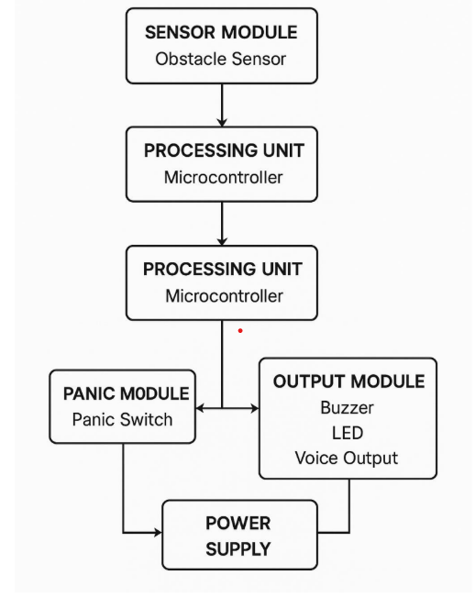
System Architecture

Slide 10
List of Modules
Object Detection Module
Audio Navigation and Alert Module

Slide 11
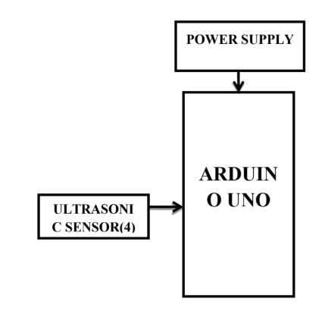
Module 1
Module 1: Object Detection Module Objective:
Detects obstacles using ultrasonic sensors placed in four directions.
Sends real-time data to Arduino Uno for processing.
Identifies the safest direction for movement and avoids collisions.
Triggers a buzzer alert when an obstacle is detected.
Enhances navigation safety for visually impaired individuals

Slide 12
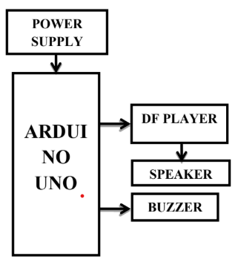
Module 2
Module 2: Alert Module
Generates real-time alerts when an obstacle is detected.
Uses a buzzer and speaker to provide audio warnings.
the user with voice instructions (e.g., "Turn left").
Ensures quick response to obstacles for safe navigation.
Enhances situational awareness without requiring visual input

Slide 13
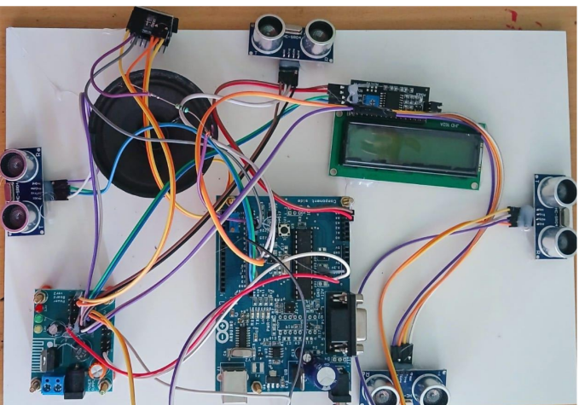
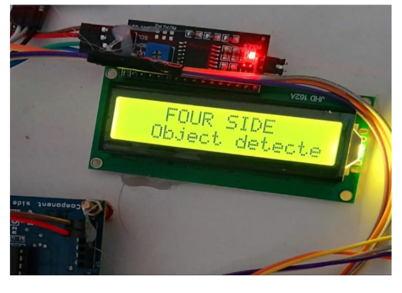
Output screenshot

Slide 14
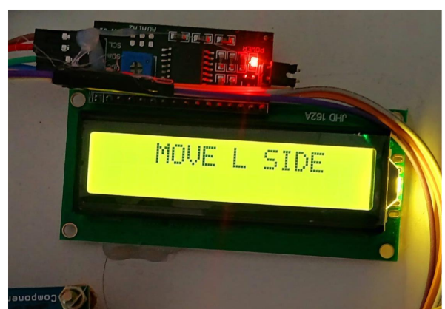
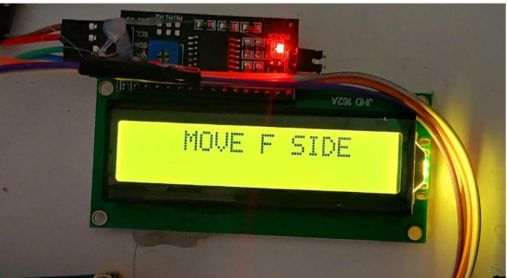
Output screenshot

Slide 15
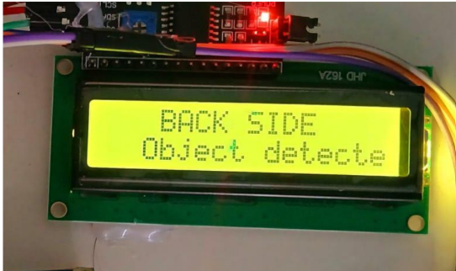
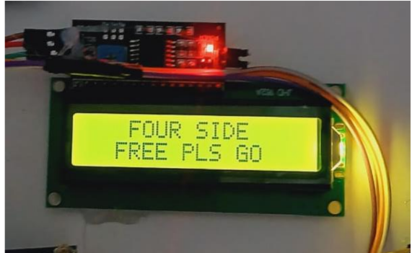
Output screenshot

Slide 16
Conclusion
The system improves safety and mobility for visually impaired people.
Uses Arduino Uno and sensors to detect obstacles.
Provides real-time audio and buzzer alerts.
Helps users navigate with confidence and avoid collisions.
Wearable design is ideal for indoor and outdoor use.
Affordable and user-friendly for wide adoption.
Future-ready with potential upgrades like GPS and AI.
Supports independence and inclusion in daily life.

Slide 17
Future Enhancement
GPS & Google Maps For outdoor navigation and route guidance.
AI & Machine Learning Predicts movement of dynamic obstacles.
Bluetooth/Wi-Fi Enables IoT-based remote monitoring for caregivers.
Vibration Alerts Silent feedback option in noisy areas.
Voice Recognition Lets users control the system with voice commands.
These upgrades will make the device smarter and more helpful in real-world use.

Slide 18
References
[1]Bourne, R. R., Flaxman, S. R., Braithwaite, T., Cicinelli, M. V., Das, A., Jonas, J. B., ... & Naidoo, K.(2017). Magnitude, temporal trends, and projections of the global prevalence of blindness anddistance and near vision impairment: a systematic review and meta-analysis. The Lancet Global Health, 5(9), e888-e897..
[2] The Financial Express. (2020). Visual impairment to increase dramatically: Study. Retrieved from https://thefinancialexpress.com.bd/health/visual-impairment to increase-dramatically-study-1579444915
[4] Wiener, W. R., Welsh, R. L., & Blasch, B. B. (2010). Foundations of orientation and mobility(Vol. 1). American Foundation for the Blind
[5] Jawale, R. V., Kadam, M. V., Gaikawad, R. S., & Kondaka, L. S. (2017, September). Ultrasonicnavigation based blind aid for the visually impaired. In 2017 IEEE International Conference onPower, Control, Signals and Instrumentation Engineering (ICPCSI) (pp. 923- 928). IEEE.

Slide 19
Thank you

